Slide 1
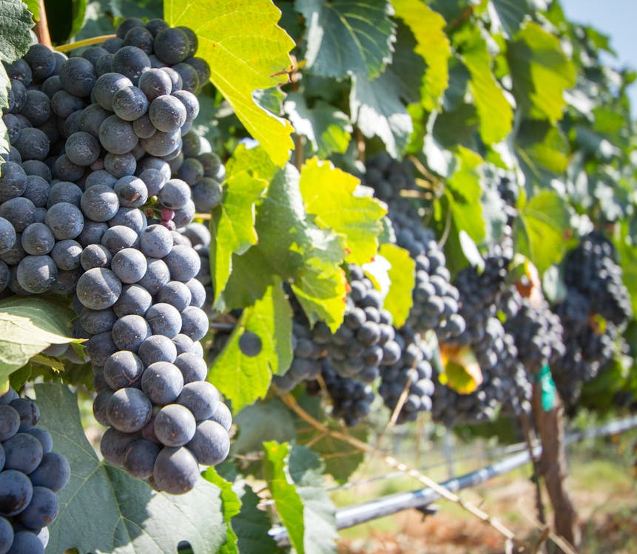
Case Study #3 - Bacchus Winery Solution
Module 11.2 Assignment
Katie Hilliard
Keanu Foltz
Amit Rizal
Amanda New

Slide 2
Agenda
Introduction
Description of Case Study
Business Rules
Finalized ERD
Description of Reports
Example Reports
Assumptions

Slide 3
Introduction
Our group agreed to take on the Bacchus Winery case study and collaborated using Discord. We carefully analyzed the case study and applied the information to create business rules and a list of assumptions. Each of us proposed an ERD and shared it in Discord until we finally composed our initial ERD. From there, we made our final ERD and each of us chose a report to create and write a script for it as well. We shared these as well and collaborated on PowerPoint to create this presentation to show our examples of the reports.

Slide 4

Case Study Description
The Bacchus Winery case study aims to streamline wine sales, employee performance, and supplier management by designing an efficient database, developing insightful reports, and documenting key assumptions.

Slide 5
Business Rules
Supply:
Each supplier provides specific items regularly (bottles, corks, labels, vats, tubing)
Track delivery schedules including actual vs expected dates
Orders should be placed and tracked online
Distribution:
Order and track shipments online
Track sale statistics and compare to sale goals
Employees:
Track employee work performance
Roles to include finance, marketing, production, and distribution
Provide monthly reports and compare to performance goals
Wines:
Merlot, Cabernet, Chablis, and Chardonnay
Track distribution & sales for each wine type

Slide 6
Business Rules Continued
Inventory:
Track by type, quantity, and age
Flag to review items over 5 years old
Marketing:
Track new offers and compare to sales
Provide a monthly/quarterly review to determine effectiveness

Slide 7
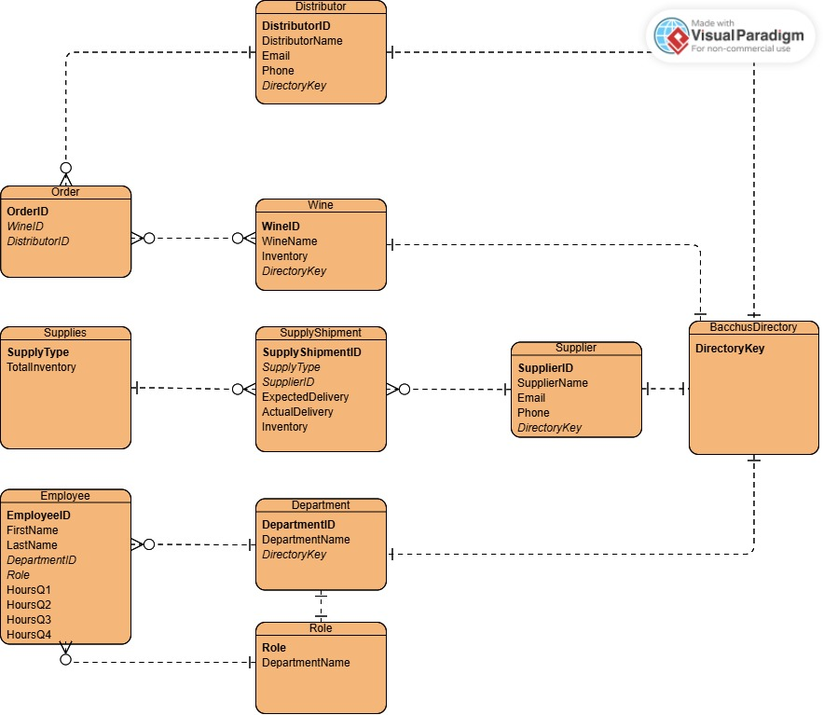
Finalized ERD

Slide 8
3 Reports:
Wine Sales
Employee Performance
Supplier Performance

Slide 9
Wine Sales Report
This report tracks wine sales performance by comparing total sales against goals.
Wine Name | Total Sales | Sales Goal | Goal Difference
Red Wine | 600.00 | 550.00 | 50.00
White Wine | 500.00 | 450.00 | 50.00

Slide 10
Employee Performance Report
Employee Name | Role | Q1 | Q2 | Q3 | Q4 | 2024 Total
Bob Ulrich | Marketing Assistant | 570 | 530 | 541 | 580 | 2221
Roz Murphy | Leader of Marketing | 560 | 512 | 540 | 578 | 2190
John Johnson | Production Worker | 500 | 502 | 500 | 500 | 2002
Janet Collins | Leader of Finance/Payroll | 480 | 500 | 513 | 495 | 1988
Henry Doyle | Production Line Manager | 480 | 480 | 480 | 480 | 1920
Maria Costanza | Leader of Distribution | 480 | 480 | 480 | 480 | 1920

Slide 11
Supplier Performance Report
This report measures supplier reliability using average delivery gaps.
Month Supplier ID Supplier Name Avg Delivery Gap (days)
2024-09 1033 Oregon Supplies 5.00
2024-09 1044 California Supplies 20.00
2024-09 1055 Nebraska Supplies 5.00
2024-10 1033 Oregon Supplies 0.00
2024-10 1044 California Supplies 20.00
2024-10 1055 Nebraska Supplies 5.00

Slide 12
Assumptions
Sales data is recorded accurately and updated quarterly.
All employees are evaluated based on individual contributions.
Supplier delivery gaps are measured in days.
Wine sales goals are predefined for performance tracking.
Data integrity is maintained throughout the database.

Slide 13
Conclusion
The Bacchus Winery case study is requesting a yearly snapshot of the business. This consists of monthly reports on suppliers, wine sales, and employee time. The purpose of these reports is to determine the state of the inventory, distribution, and employees. We worked together to develop examples for each report, and they meet the needs Stan and Davis requested.

Slide 14
Thank you
Group Case Study 3
CSD-310

